Slide 1

Egorov Research Group Fall Recap
December 4th, 2023
Mohan Shankar

Slide 2
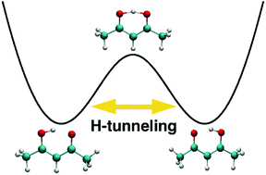
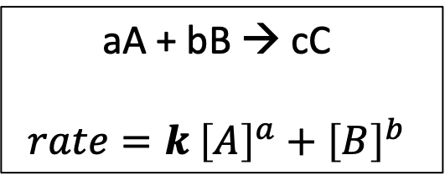
Transition State Theory (TST)
Background:
Developed to explain chemical reaction rates
Assumes particles behave classically
Examples:
Nuclear reactions
R-H functionalization rxns in catalysis
Arbitrary Elementary Rxn.
aA + bB → cC
$$rate=k {\left[A\right]}^{a}+{\left[B\right]}^{b}$$
Phys. Chem. Chem. Phys., 2021, 23, 7758

Slide 3
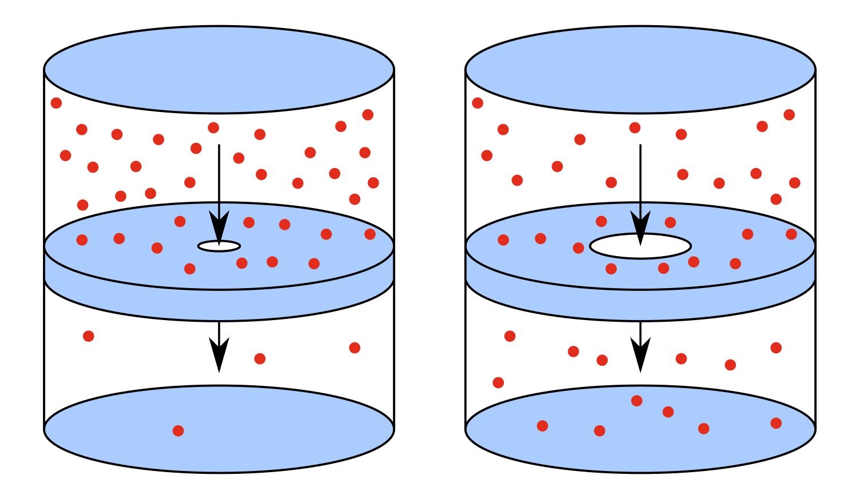
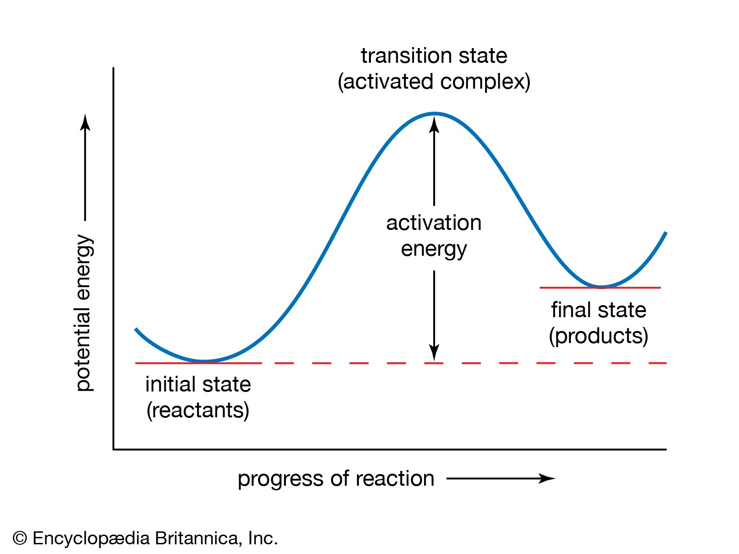
Quantum Effusion
Overview:
Use modified 2D Particle-in-a-Box (P.I.B.) to model effusion → find exact thermal rate constants
Goal:
Compare exact results to validate ring polymer molecular dynamics (RPMD) results→ Quantum Transition State Theory (QTST)
Notes:
First step is to re-create P.I.B. results which was solved classically; compare classical to quantum results and use these exact results to validate RPMD

Slide 4
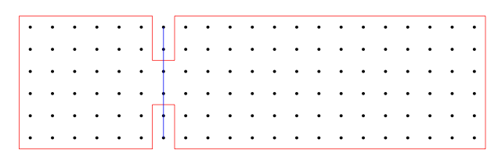
The System
Sigurðarson, A.E. Calculation of the Quantum Mechanical Effusion Rate out of a 2D Box. BSc. Dissertation, School of Engineering and Natural Sciences University of Iceland, 2021.

Slide 5
The System

Slide 6
The System
Walls → ψ = 0
Inside the Box → ψ ≠ 0

Slide 7
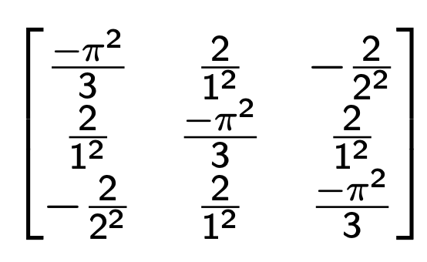
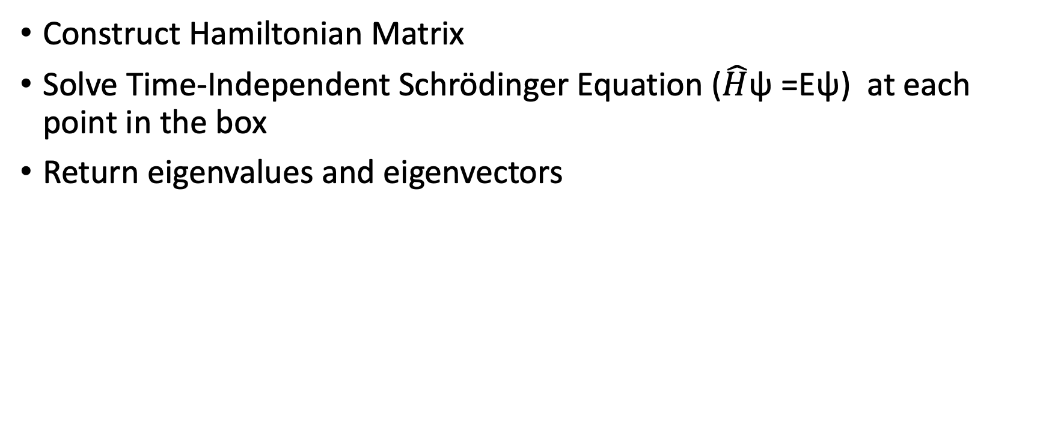
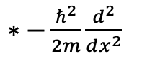
Methods
Construct Hamiltonian Matrix
Solve Time-Independent Schrödinger Equation ($\hat{H}$ψ =Eψ) at each point in the box
Return eigenvalues and eigenvectors
Apply weights
$∗−\frac{ℏ^{2}}{2m}\frac{d^{2}}{dx^{2}}$
Notes:
Pick a point of interest; Padé approximant for weights which assumes equispaced grid

Slide 8
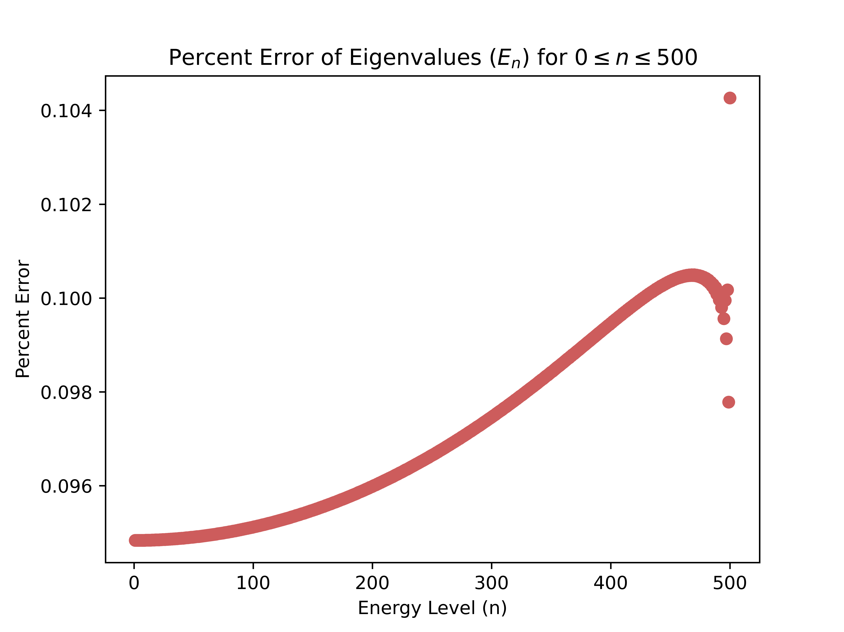
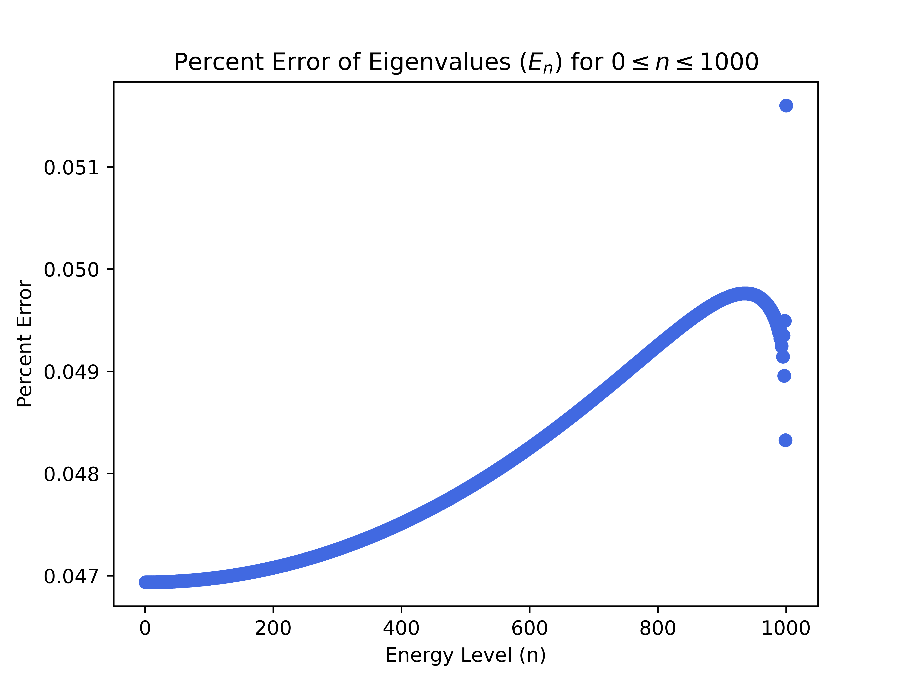
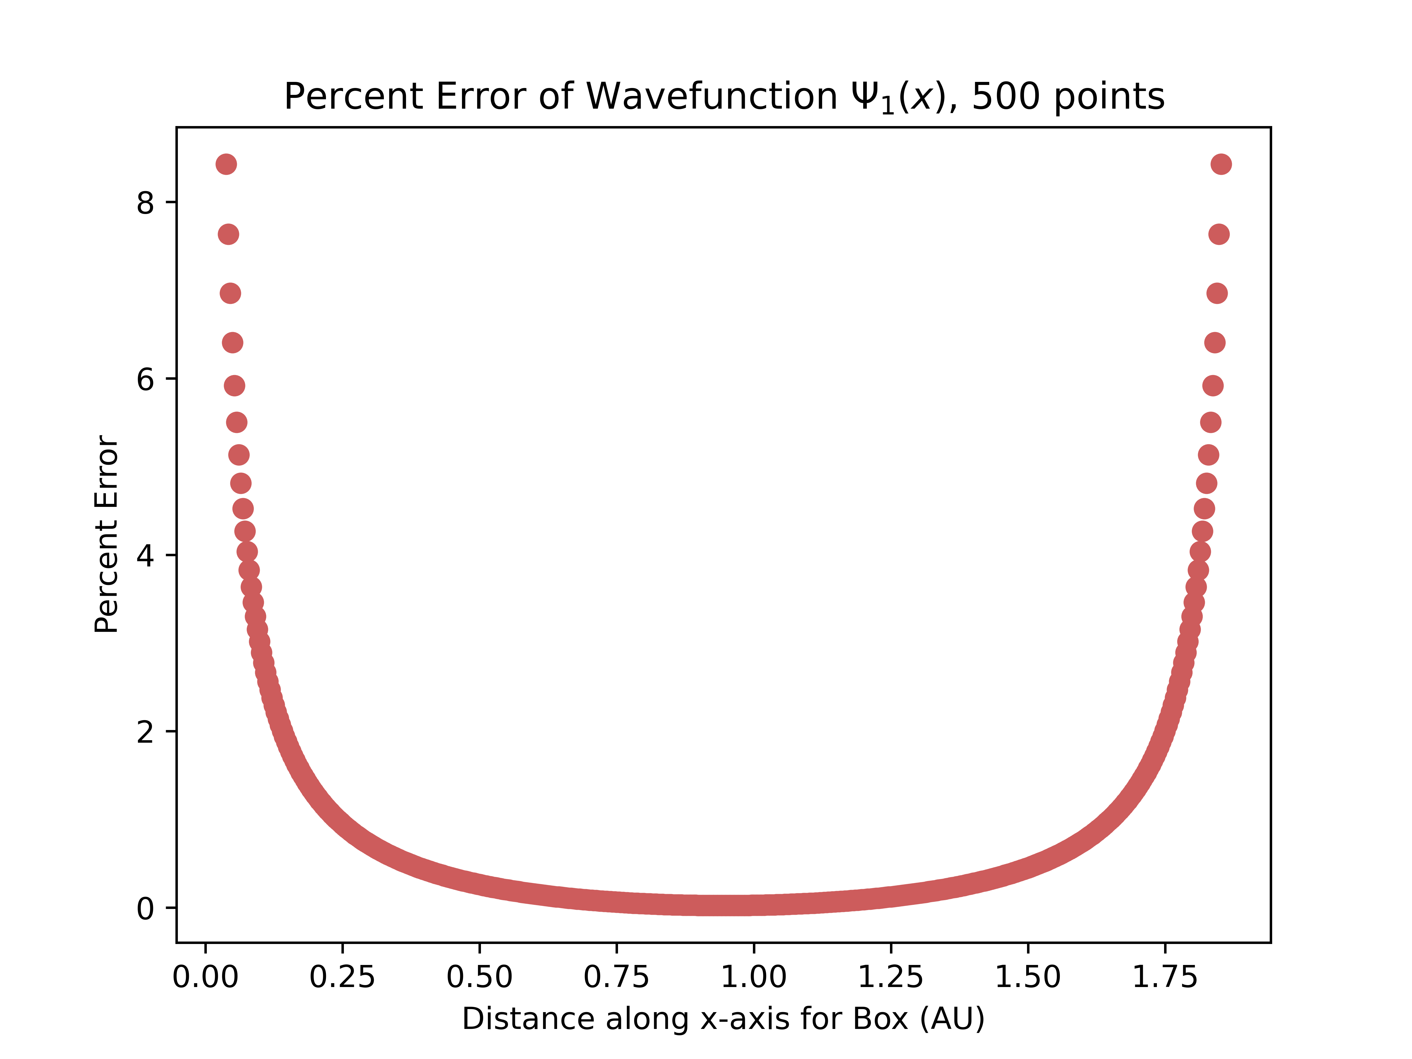
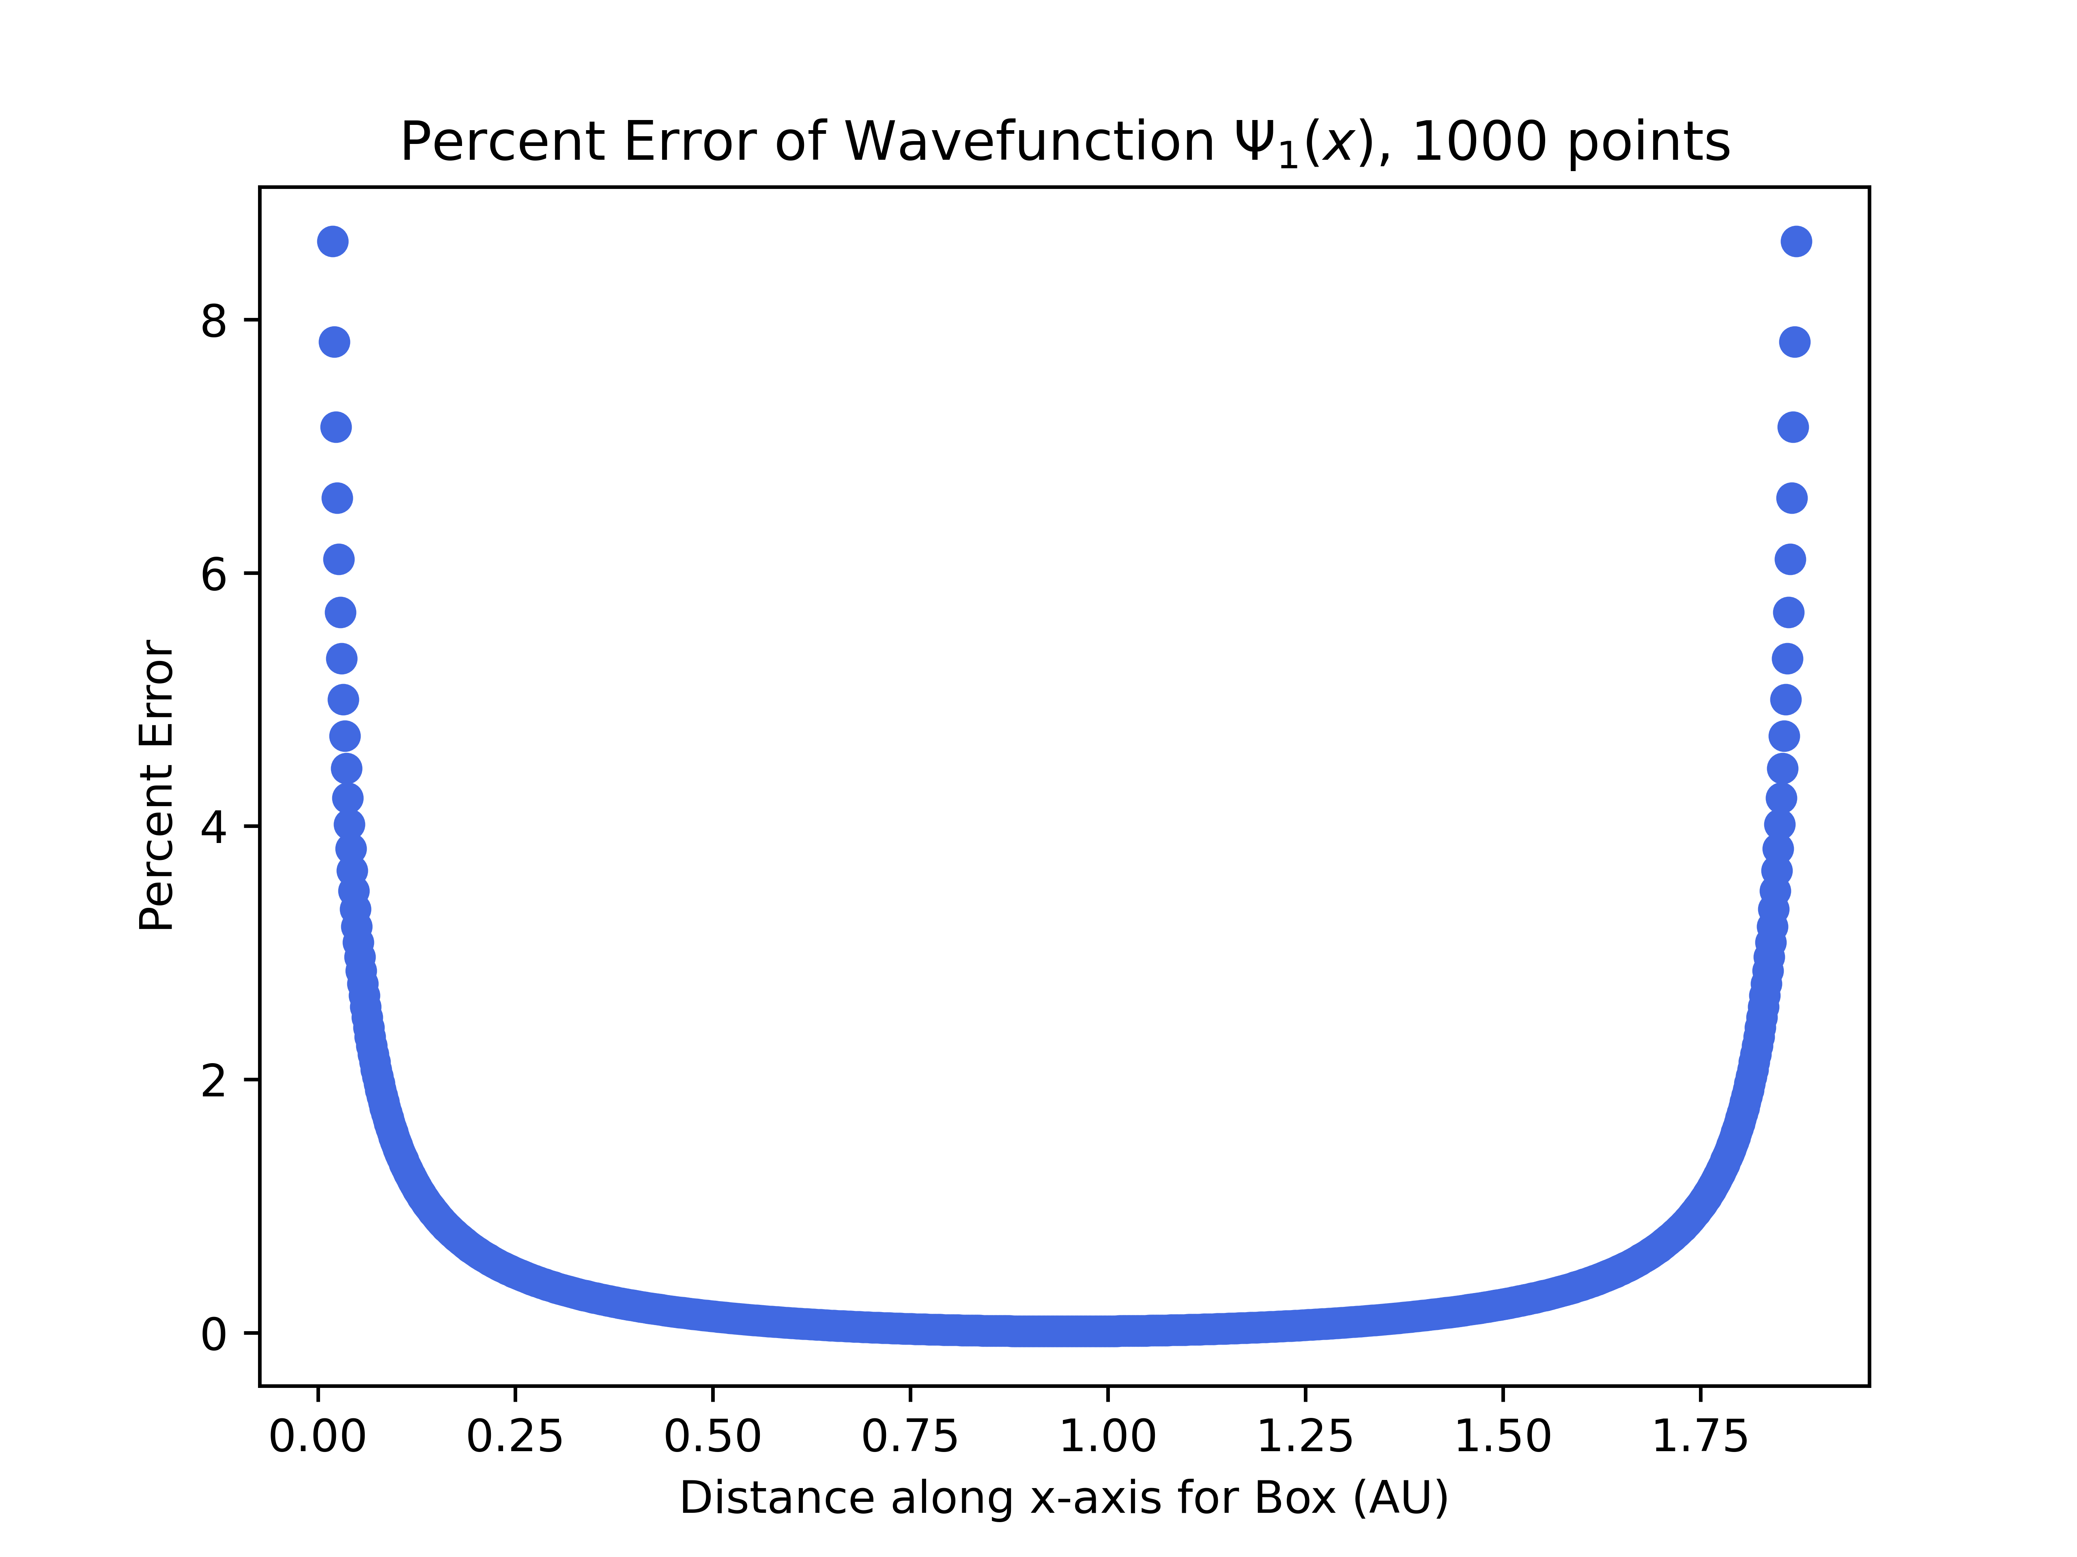
P.I.B.in ℝ¹
Inc. # of Points
Inc. # of Points
Notes:
Diminishing returns for # of points in box; error blows up at walls

Slide 9
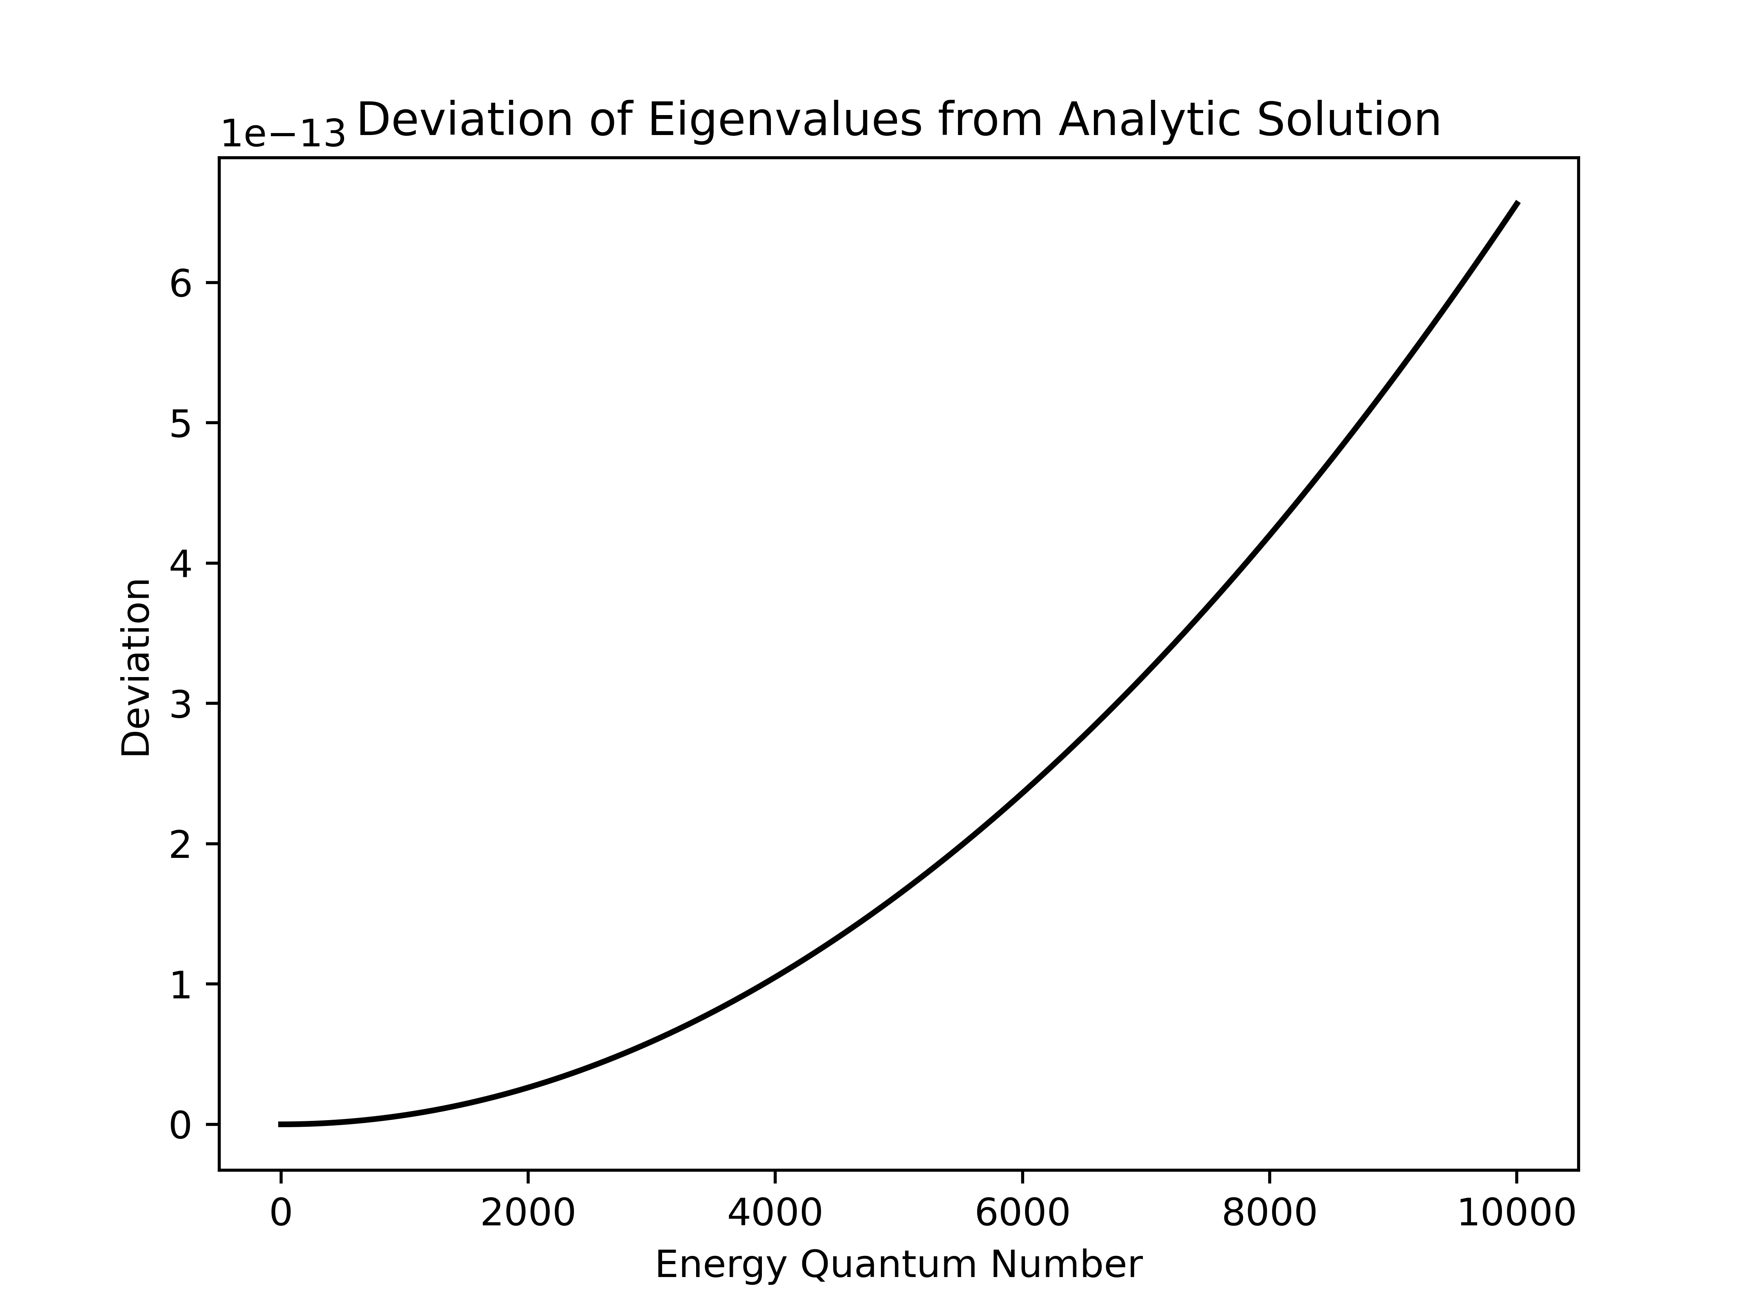
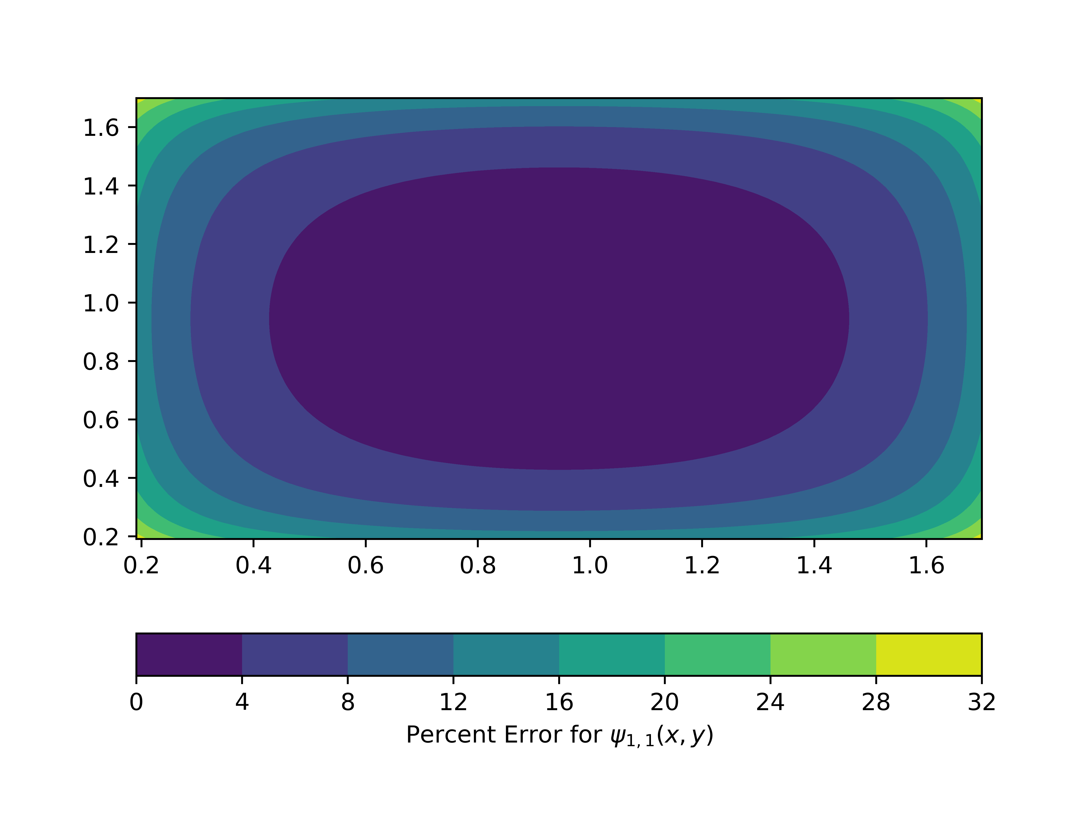
P.I.B.in ℝ²

Slide 10
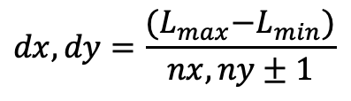
Grid Spacing Issue
$$dx, dy=\frac{{(L}_{max}−L_{min})}{nx, ny±1}$$

Slide 11
Grid Spacing Issue
≅
$$dx, dy=\frac{{(L}_{max}−L_{min})}{nx, ny±1}$$

Slide 12
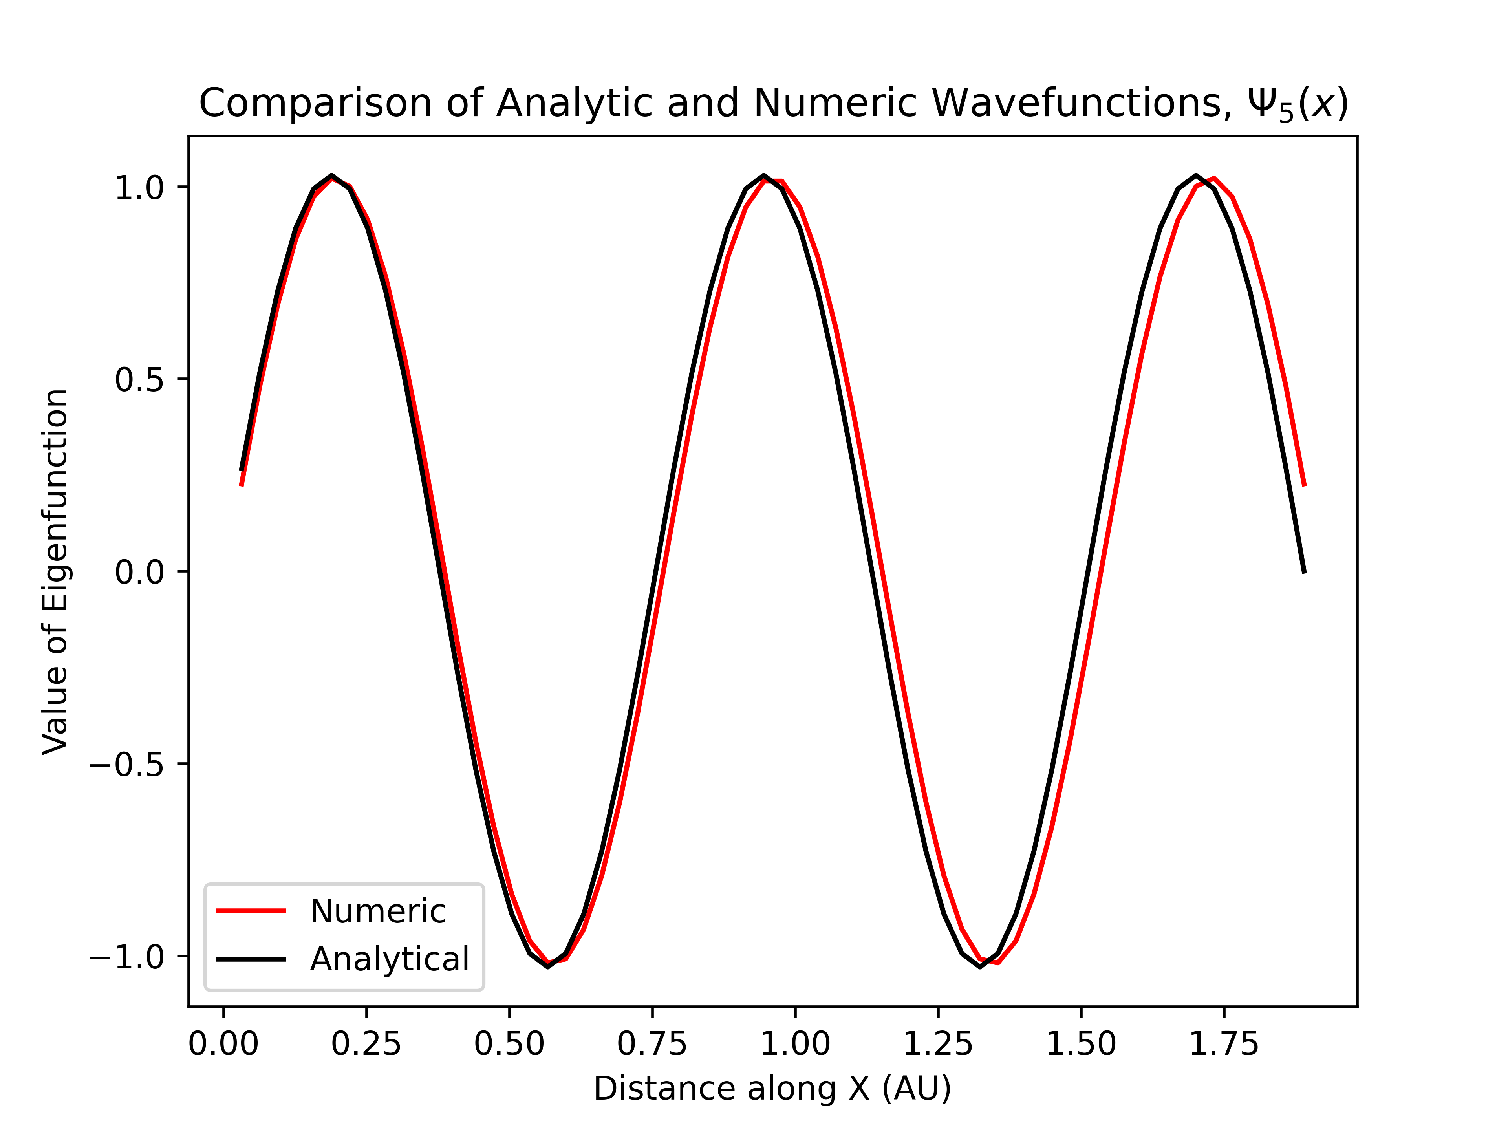
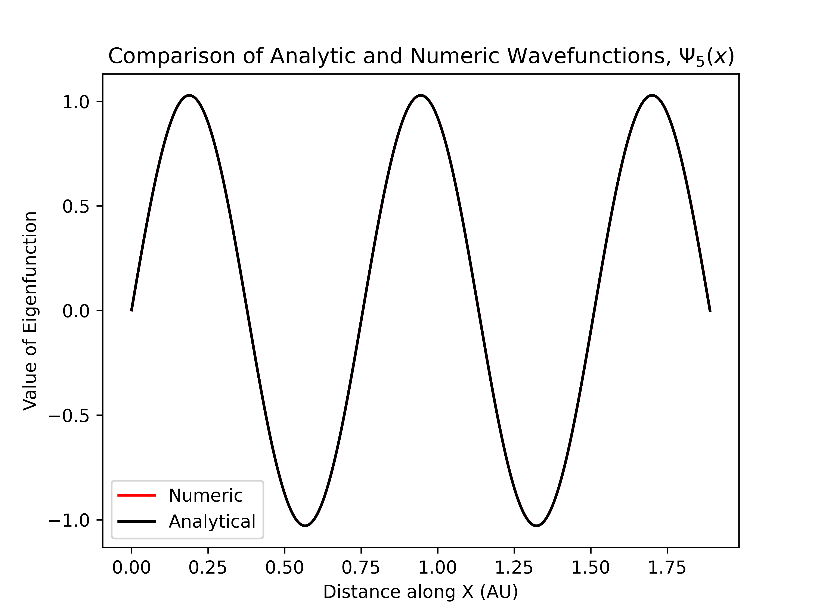
Increasing Points on Spacing Issue in ℝ¹
$$ψ5\left(x\right) where nx=60$$
$$ψ5\left(x\right) where nx=600$$

Slide 13
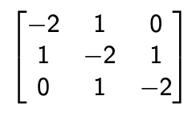
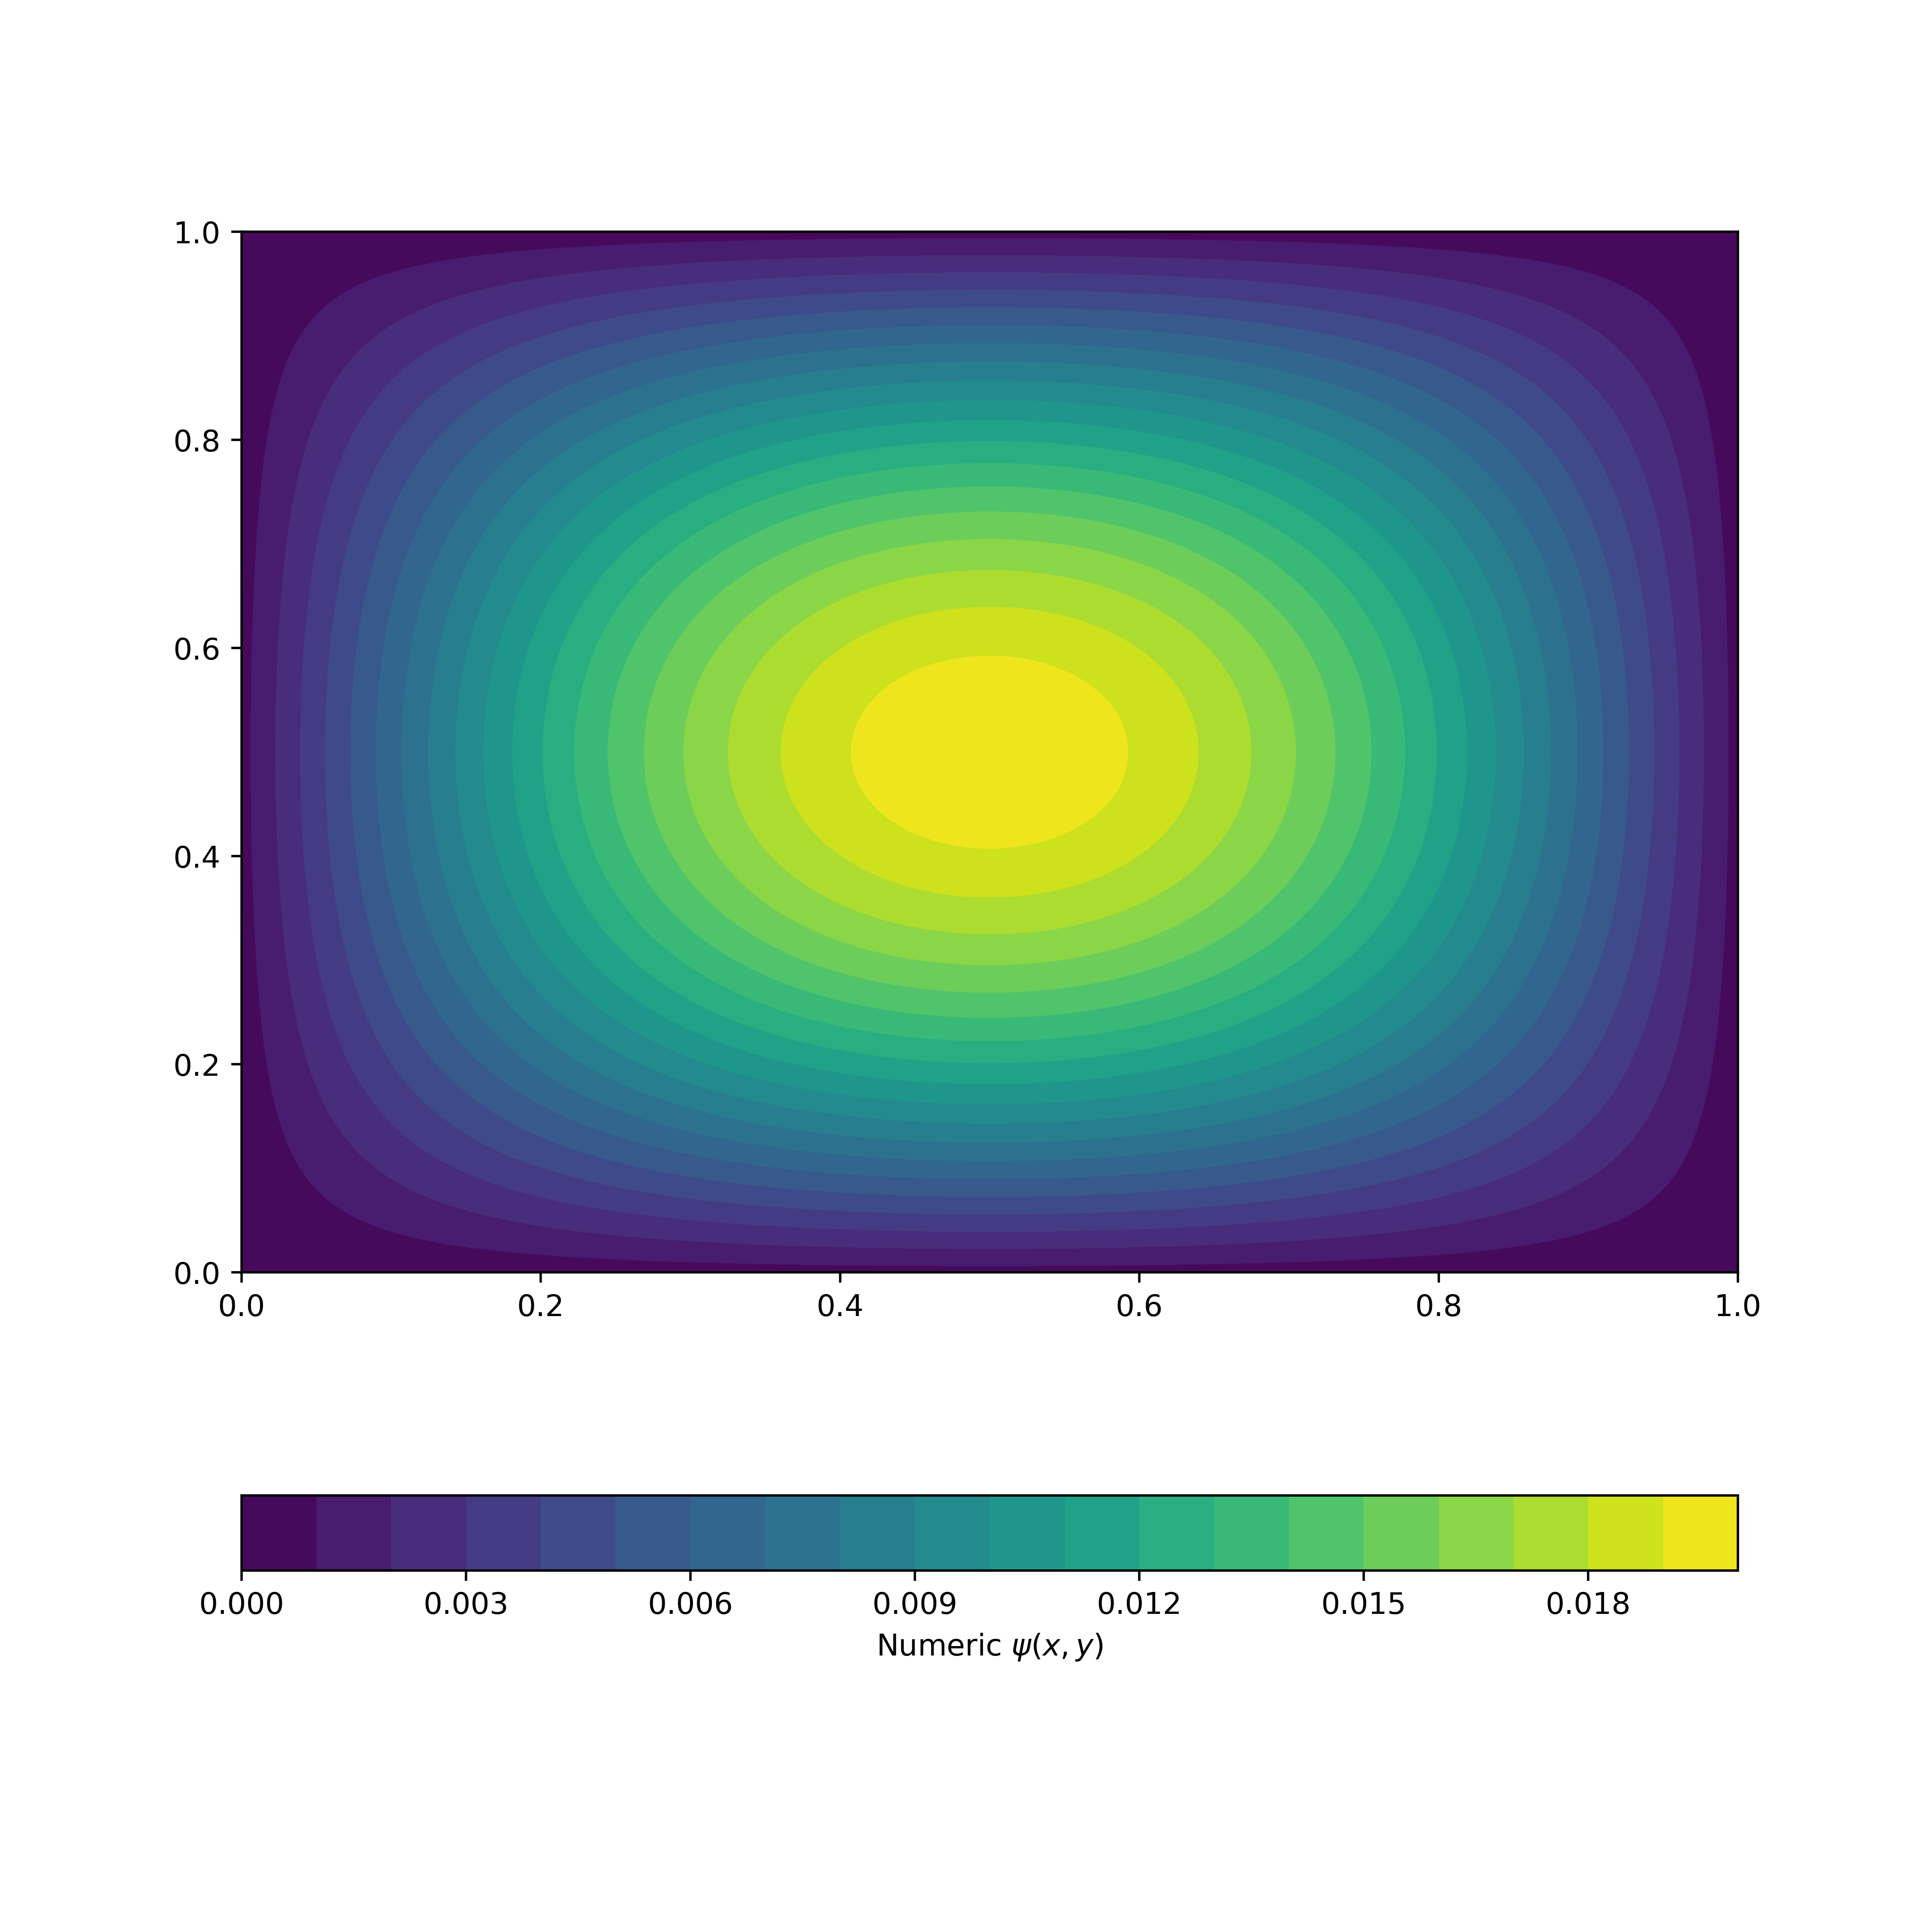
Future Avenues
Consider alternative population of Hamiltonian
Apply weights

Slide 14
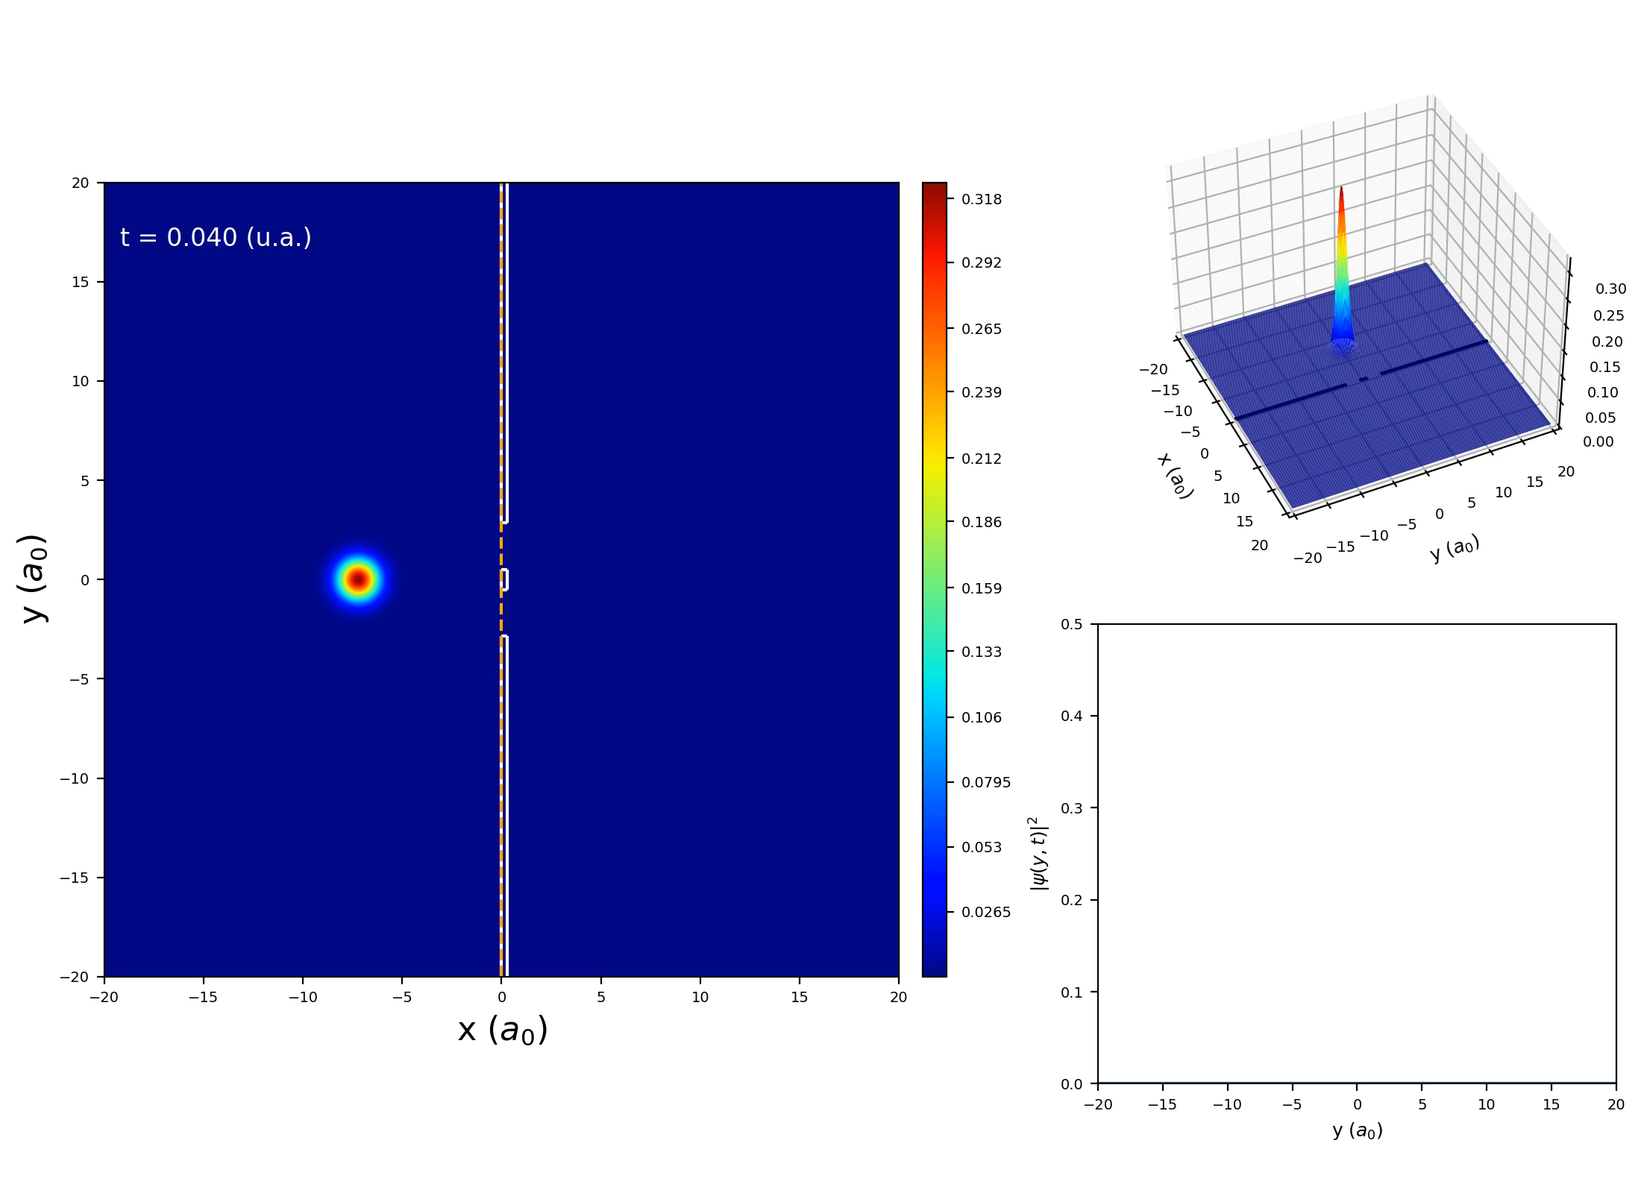
Future Avenues
Wavepacket Diffraction

Slide 15
“Experiment” in Stat Mech
Theory (Computation)
Physical
Experiment
Real System
Model System
Exact
Approx.
Monte Carlo (MC), Molecular Dynamics (MD)
Density Functional Theory (DFT)
Data
Compare
Results
Compare
Results

Slide 16
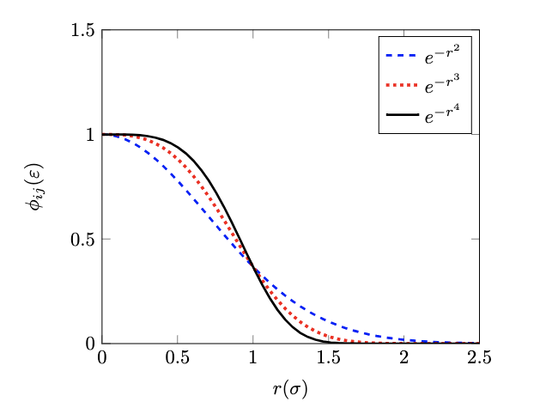
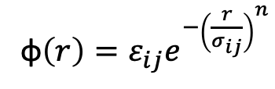
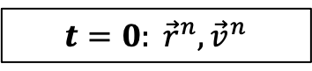
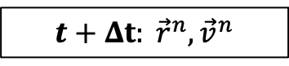
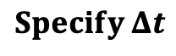
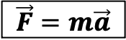
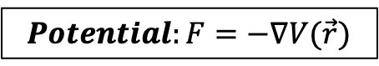
Molecular Dynamics Schematic
$$t=0: {\vec{r}}^{n}, {\vec{v}}^{n}$$
$$Potential:F=−∇V(\vec{r})$$
$$Specify Δt$$
$$\vec{F}=m\vec{a}$$
Example Potential (GEM-n)
$$t+Δt: {\vec{r}}^{n}, {\vec{v}}^{n}$$
φ$\left(r\right)=ε_{ij}e^{−{\left(\frac{r}{σ_{ij}}\right)}^{n}}$

Slide 17
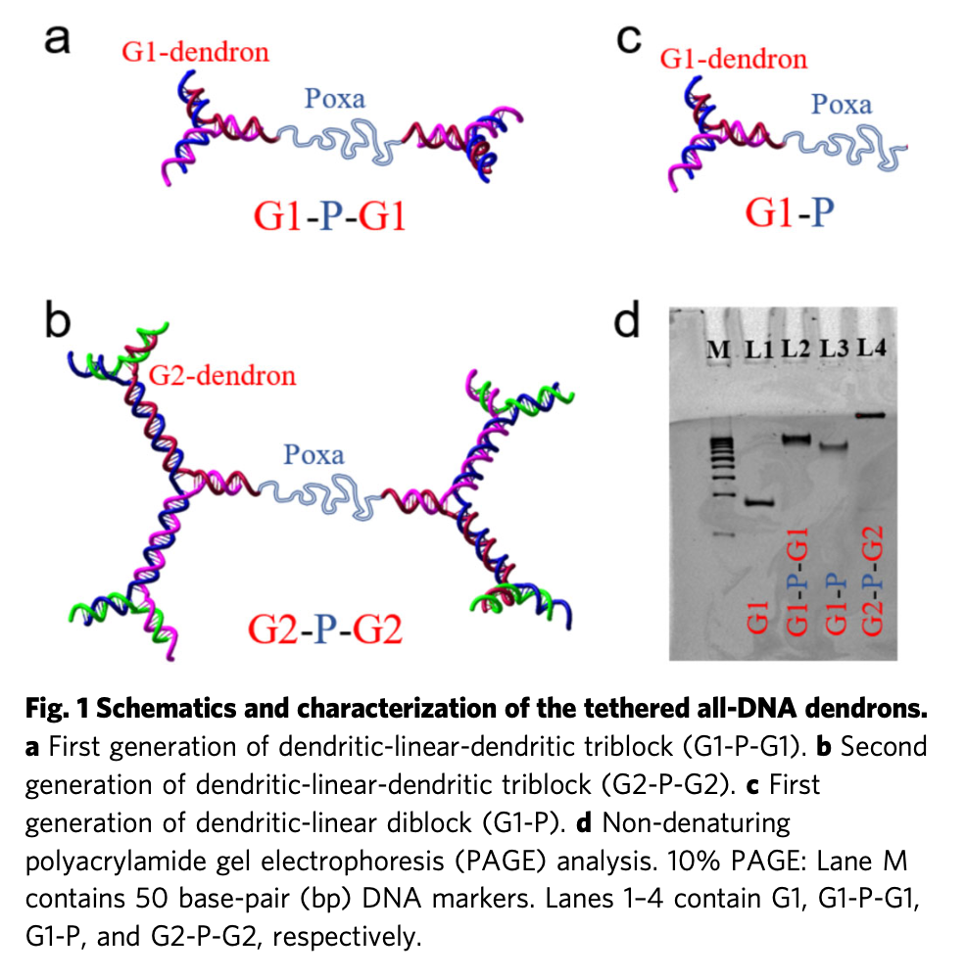
Cluster Crystals
Experimental Results
Confirmed by experiment to exist
Self-assembling structure
Dendrimers can be used to improve efficiency of drug molecules among other features
Stiakakis, E., Jung, N., Adžić, N. et al. Self assembling cluster crystals from DNA based dendritic nanostructures. Nat Commun 12, 7167 (2021). https://doi.org/10.1038/s41467-021-27412-3

Slide 18
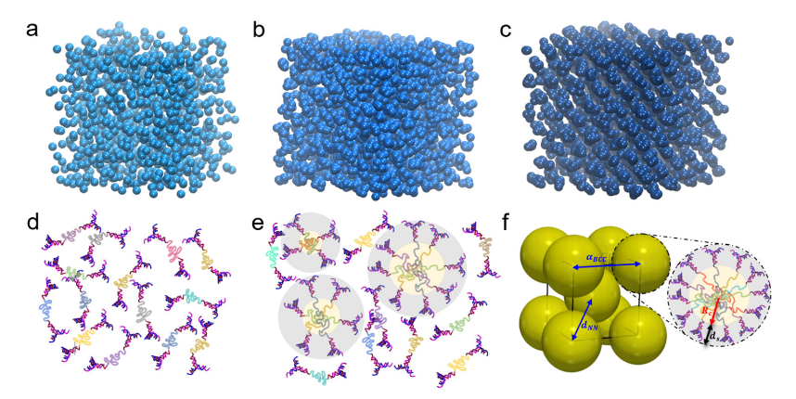
Cluster Crystals
Coarse-Graining → model particles as a sphere
Main consideration is the physics
Stiakakis, E., Jung, N., Adžić, N. et al. Self assembling cluster crystals from DNA based dendritic nanostructures. Nat Commun 12, 7167 (2021). https://doi.org/10.1038/s41467-021-27412-3

Slide 19
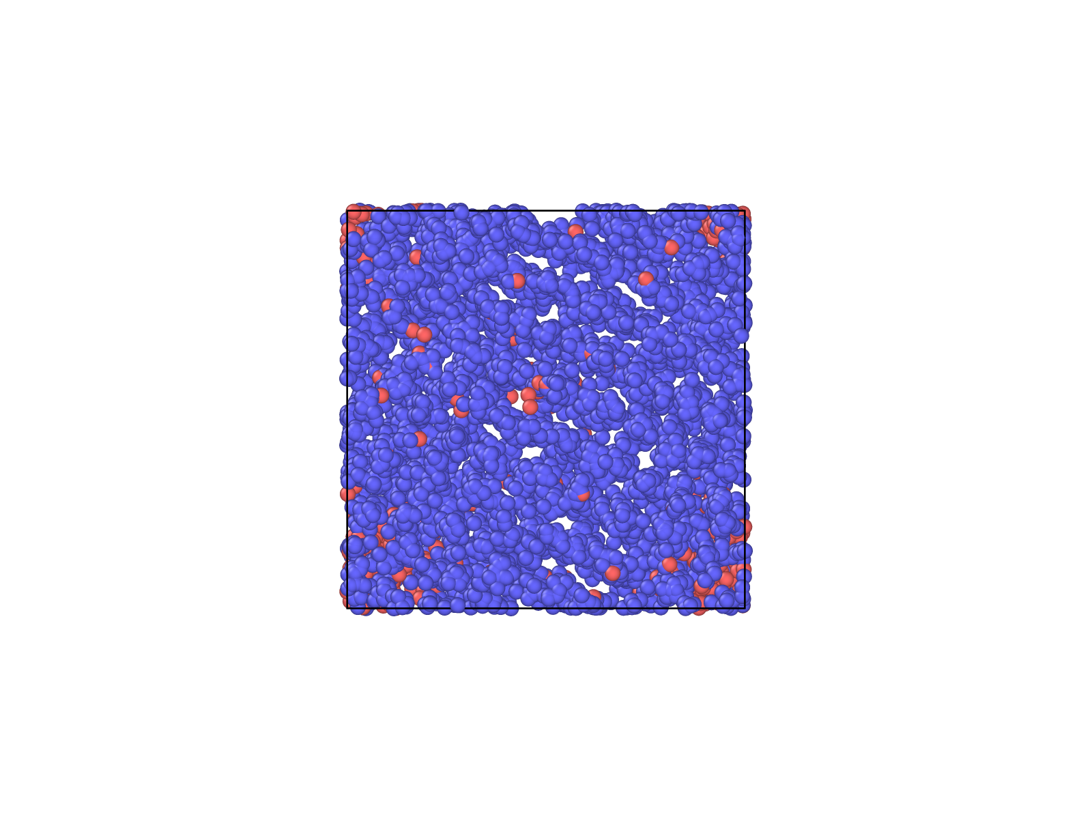
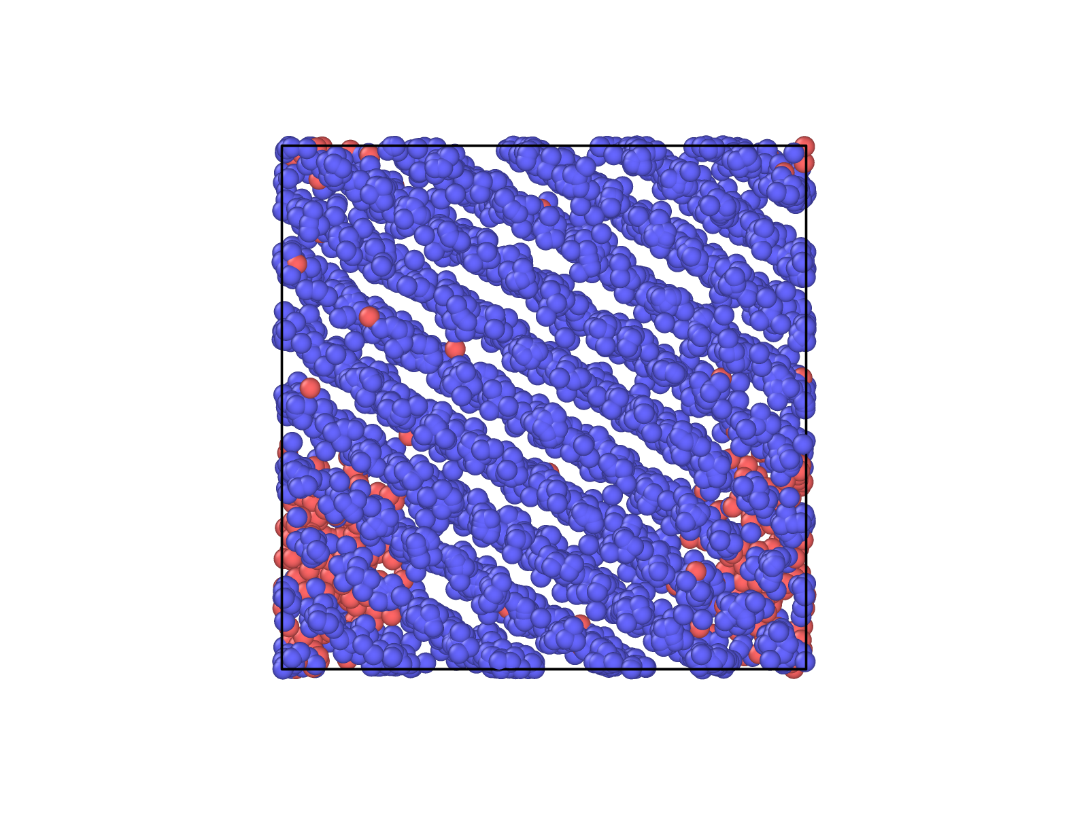
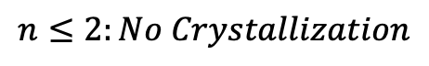
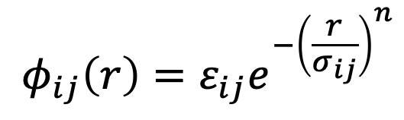
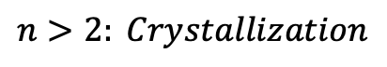
GEM-n
Explore interactive potential defined by:
Only repulsive interactions
$$φ_{ij}\left(r\right)=ε_{ij}e^{−{\left(\frac{r}{σ_{ij}}\right)}^{n}}$$
$$n≤2:No Crystallization$$
$$n>2: Crystallization$$
Simulation

Slide 20
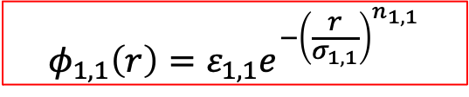
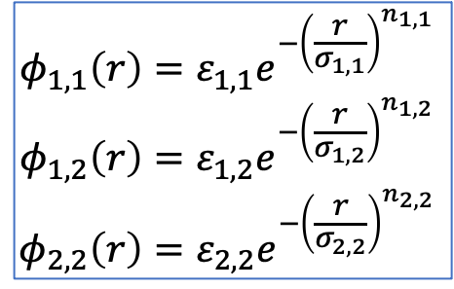
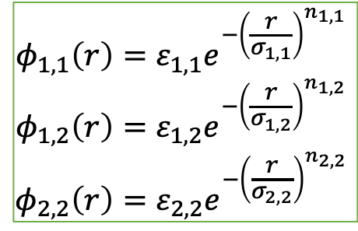
GEM-n Overview
1
GEM-2, GEM-4 Two Particle Types
Compare to published results
S. D. Overduin and C. N. Likos 2009 EPL 85 26003.
2
GEM-4 Single Particle Type
Compare to Collaborator’s thesis
Mladek, B.M. Exotic phenomena in the phase behaviour of soft matter systems. Ph.D. Dissertation, Vienna University of Technology, 2007.
$$φ_{1,1}\left(r\right)=ε_{1,1}e^{−{\left(\frac{r}{σ_{1,1}}\right)}^{n_{1,1}}}$$
$$φ_{1,2}\left(r\right)=ε_{1,2}e^{−{\left(\frac{r}{σ_{1,2}}\right)}^{n_{1,2}}}$$
$$φ_{2,2}\left(r\right)=ε_{2,2}e^{−{\left(\frac{r}{σ_{2,2}}\right)}^{n_{2,2}}}$$
$$φ_{1,1}\left(r\right)=ε_{1,1}e^{−{\left(\frac{r}{σ_{1,1}}\right)}^{n_{1,1}}}$$
3
Dimer System
Novel
$$φ_{1,1}\left(r\right)=ε_{1,1}e^{−{\left(\frac{r}{σ_{1,1}}\right)}^{n_{1,1}}}$$
$$φ_{1,2}\left(r\right)=ε_{1,2}e^{−{\left(\frac{r}{σ_{1,2}}\right)}^{n_{1,2}}}$$
$$φ_{2,2}\left(r\right)=ε_{2,2}e^{−{\left(\frac{r}{σ_{2,2}}\right)}^{n_{2,2}}}$$
* {N, V, T} Ensemble for All *

Slide 21
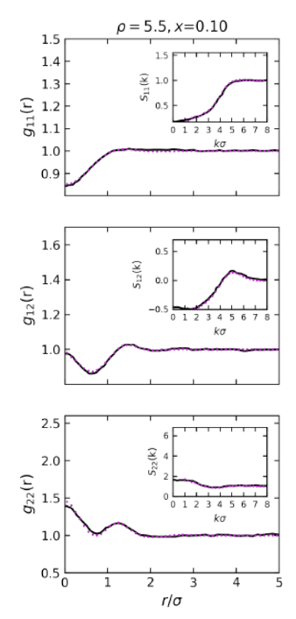
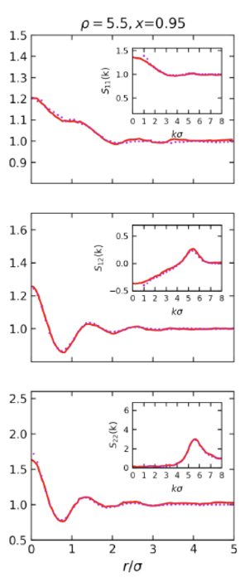
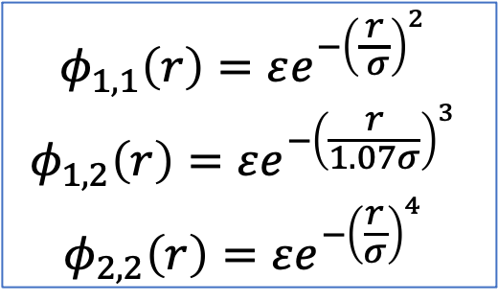
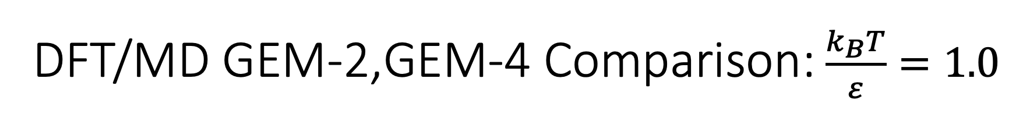
DFT/MD GEM-2,GEM-4 Comparison: $\frac{k_{B}T}{ε}=1.0$
$$φ_{1,1}\left(r\right)=εe^{−{\left(\frac{r}{ σ}\right)}^{2}}$$
$$φ_{1,2}\left(r\right)=εe^{−{\left(\frac{r}{1.07σ}\right)}^{3}}$$
$$φ_{2,2}\left(r\right)=εe^{−{\left(\frac{r}{σ}\right)}^{4}}$$

Slide 22
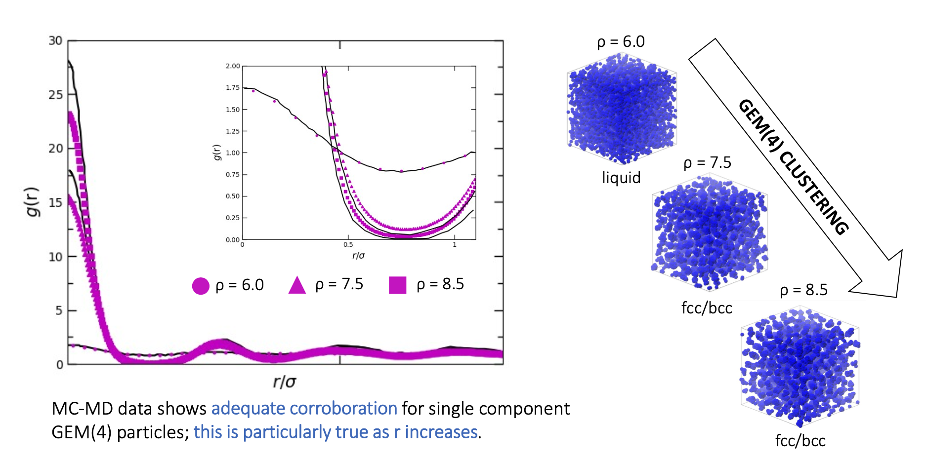


MC/MD GEM-4 Comparison: $\frac{k_{B}T}{ε}=1.1$
GEM-4 Clustering
$$φ_{1,1}\left(r\right)=εe^{−{\left(\frac{r}{σ}\right)}^{4}}$$

Slide 23
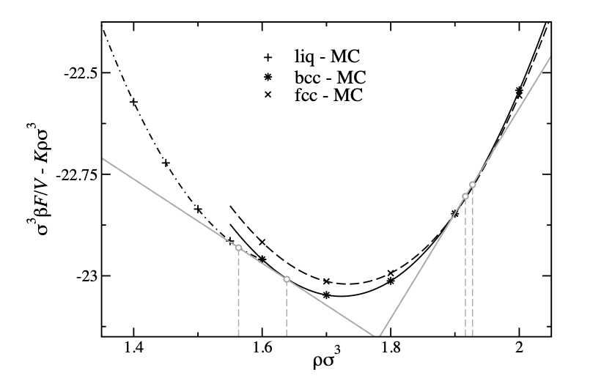
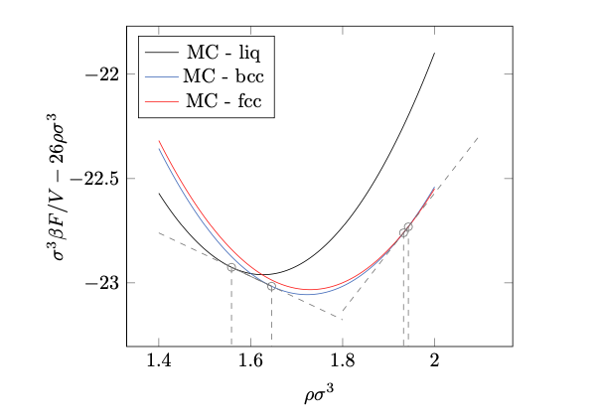
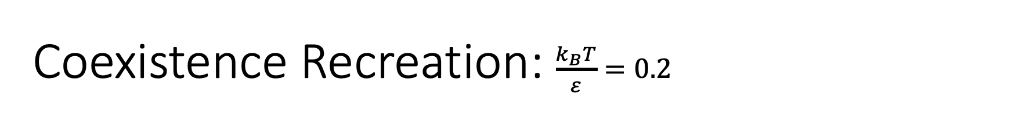
Coexistence Recreation: $\frac{k_{B}T}{ε}=0.2$
Original
Recreation

Slide 24
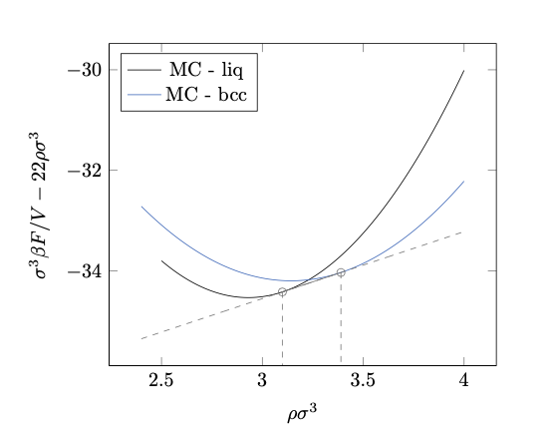
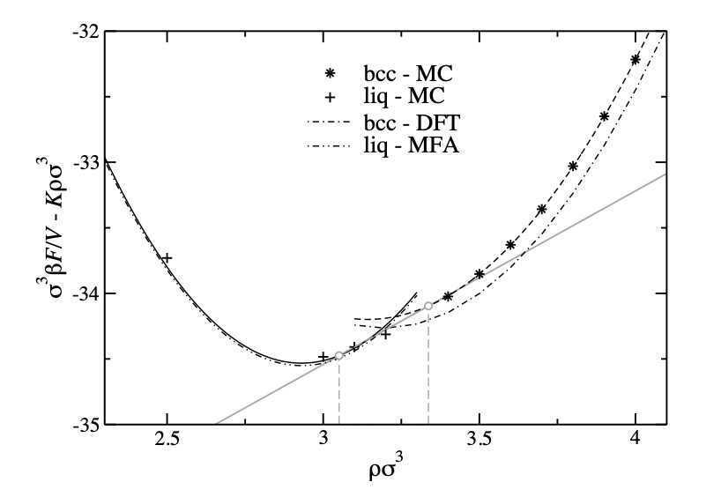
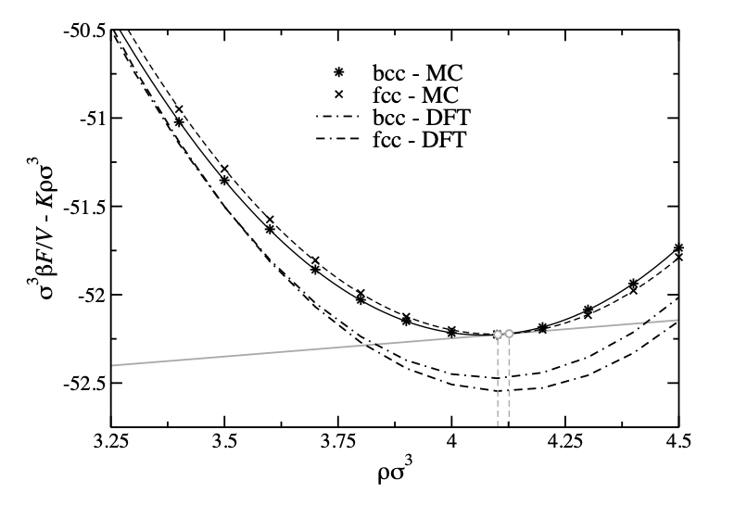
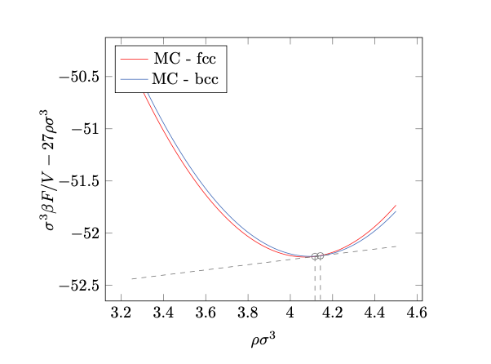
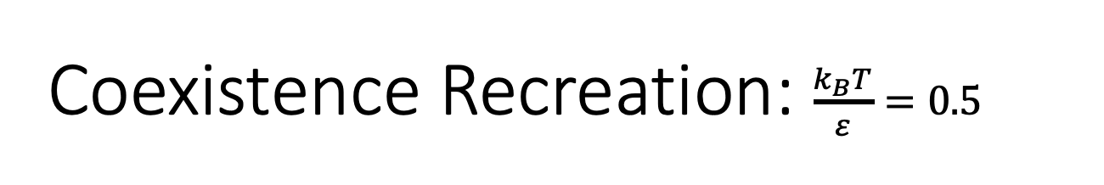
Coexistence Recreation: $\frac{k_{B}T}{ε}=0.5$
Originals
Recreations

Slide 25



Dimers
$$φ_{1,1}\left(r\right)=ε_{1,1}e^{−{\left(\frac{r}{σ_{1,1}}\right)}^{n}}$$
GEM-2:
$$φ_{1,2}\left(r\right)=ε_{1,2}e^{−{\left(\frac{r}{σ_{1,2}}\right)}^{n}}$$
GEM-2,4:
$$φ_{2,2}\left(r\right)=ε_{2,2}e^{−{\left(\frac{r}{σ_{2,2}}\right)}^{n}}$$
GEM-4:
Notes:
How does LAMMPS define the bonds

Slide 26


Dimer vs. GEM-4
Test Dimer system where 𝞮_{2,2} and 𝞮_{2,4} = 0; $\frac{k_{B}T}{ε}=0.5$
Notes:
Low density results in greater effects when Widom insertion is performed

Slide 27



Dimer vs. GEM-4
Test Dimer system where 𝞮_{2,2} and 𝞮_{2,4} = 0 ; $\frac{k_{B}T}{ε}=0.5$

Slide 28

Future Avenues
Dimer system where 𝞮_{2,2} and 𝞮_{2,4} ≠ 0
Notes:
KbT/e = 0.5, e_1,1 = 0.1, e_1,2 = sqrt(0.1), e_2,2 = 1

Slide 29
Thank You!
Any Questions?

Slide 30


Tunneling and Zero Point Energy
Tunneling:
Zero Point Energy:
$$E_{n}=\frac{ℏ^{2}π^{2}}{8ml^{2}} →ΔxΔp≈ℏ →Δx \sim l →Δp \sim \frac{ℏ}{l} →E_{min}=\frac{Δp^{2}}{2m}≠0$$
Notes:
Zero-Point Energy means there is still some KE at T = 0 Kelvin due to QM contributions

Slide 31

RPMD
Notes:
Way of discretizing Quantum Path Integral

Slide 32

RPMD
Chandler, D. Wolynes, P.G. Exploiting the isomorphism between quantum theory and classical statistical mechanics of polyatomic fluids.
J. Chem. Phys. 74, 4078–4095 (1981)
Notes:
Way of discretizing Quantum Path Integral

Slide 33

Correlation Functions
Describes a statistical relationship between quantities

Slide 34


Kinetics with Correlation Functions
Flux: Number of particles per unit time through a point, x = s
Notes:
Have flux-flux which should tend to zero and flux-side which should be positive

Slide 35


Radial Distribution Function, g(r)
Notes:
Concentric circles to describe how density varies as a function of distance from a reference particle; S(k) more common from expt due to scattering though

Slide 36

Likos Phase Diagram

Slide 37



Langevin Dynamics
Langevin thermostat maintains temperature by modifying Newton’s Eqns. of motion
Notes:
F_{i} is the force acting on atom i due to the interaction potential, γ_{i} is a friction coefficient, and f_{i} is a random force simulating the random kicks by the damping of particles between each other due to friction. The random numbers are chosen from a Gaussian distribution with the following variance

Slide 38




Common Tangent Construction
$$P_{1}=P_{2}→ P=−\left(\frac{∂F}{∂V}\right) →Equal Slopes$$
$$μ=\frac{F}{N}+\frac{PV}{N}$$
$$μ_{1}=μ_{2}→ Equal Intercept$$

Slide 39

Coexistence
Determine coexistence by the following:
${0= μ}_{c}=\frac{{F(μ}_{c})+P(μ_{c})\text{ − }{μ(μ}_{c})N}{N_{c}}$
$μc$ is the work necessary to introduce a new lattice site
All other quantities are constrained by $μc$leading to the expression above (Note: {N, V, T} Ensemble)
Methods of Acquisition:
Density Functional Theory (DFT)→ F($μc$)
Widom Insertion →$μ(μc$)
LAMMPS logfile → P$(μc$)

Slide 40


Mladek Phase Diagram

